Slide 1

Investigating Heterogeneous Data In The National COVID Cohort Collaborative Data Enclave (N3C) System Using PySpark
Mirna Elizondo (m_e172)
Advisor: Jelena Tesic,
Computer Science
Notes:
https://ncats.nih.gov/n3c

Slide 2
Abstract
I present an end-to-end machine learning pipeline for aggregating, analyzing, and modeling the National COVID Cohort Collaborative (N3C) data on the Enclave system. To achieve this, I utilized Apache's PySpark MLlib functions and scale the approach on Enclave to the entire dataset to process millions of clinical observations to identify the most impactful attributes that support an accurate prediction model.
The pipeline is optimized for deployment on N3C Enclave and aims to inform clinical decisions by identifying the most relevant factors that would lead to death. The study implements three feature selectors and two machine learning methods in PySpark(v3.4) on the Enclave for processing noisy tabular data. Multiple conditions, observations, and drugs relevant to COVID-19 diagnoses and treatment were also identified.

Slide 3
TABLE OF CONTENTS
INTRODUCTION
MOTIVATION
METHODOLOGY
RESULTS
National COVID Cohort Collaborative (N3C)
OMOP Model
PySpark
Covid-19 Pandemic
Related Work
Why Random Forest?
EDA
Feature Selection
Top 25 Id’s
Modeling
Conclusion
Future Work

Slide 4


Introduction
What is the National COVID Collaborative or the N3C?
An electronic system of health record-based de-sensitized data sets related to Covid-19 pandemic and patients. This data is harmonized, mapped, and curated by the Center for Data to Health (CD2H). [1]
The data and information created in the Enclave system are bound to it following level-2 clearance with DUR.
Mission: “Identify patients and controls by establishing a common COVID-19 phenotype that will define the data pull for the limited data set, create a "white glove" service to obtain data from each site by building easily adaptable scripts for each clinical data model, and ingest data into a secure location, per approved institutional agreements”[2]
Enclave Tools:
[3]
[3]
Notes:
https://covid.cd2h.org/tools

Slide 5
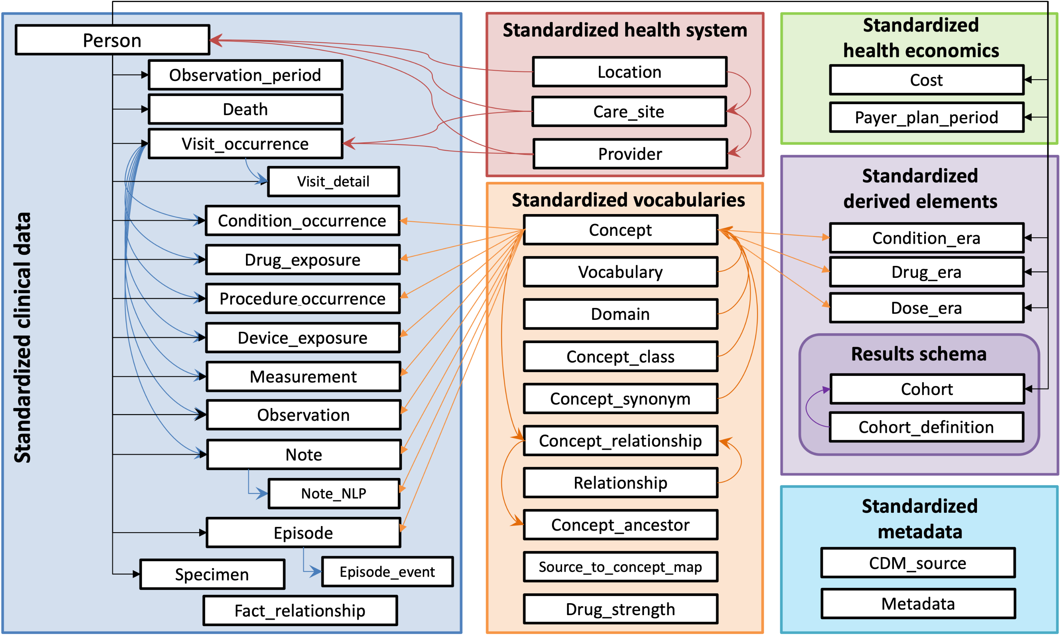
‘White Glove’
“The Observational Medical Outcomes Partnership (OMOP) Common Data Model (CDM) is an open community data standard, designed to standardize the structure and content of observational data and to enable efficient analyses that can produce reliable evidence” [7]
[7]

Slide 6

PySpark
[4]
“Enclave natively with Spark SQL, or with R or Python using the SparkR or PySpark packages” [3]
Why use PySpark in the Enclave?
“In Palantir Foundry, which is a data operating system, datasets are automatically linked via parent-child (or, source-result) directed tree relationships. This makes it easy for anyone to trace the data lineage of Spark transformations.”[5]
Overall?
It is structurally like SQL, but the data frames are immutable meaning it cannot be changed after creation but can be transformed.
Enclave benefits from Spark's lazy evaluation, an action (made up of transformation tasks) is performed only when a build is triggered,
Resilient Distributed Datasets (RDD) is the underlying structure of the data frames allowing for several transformations ran in parallel.
Spark Data Frames are optimized for large data sets leading to the assumption that our models should perform better in PySpark over solely Python.

Slide 7
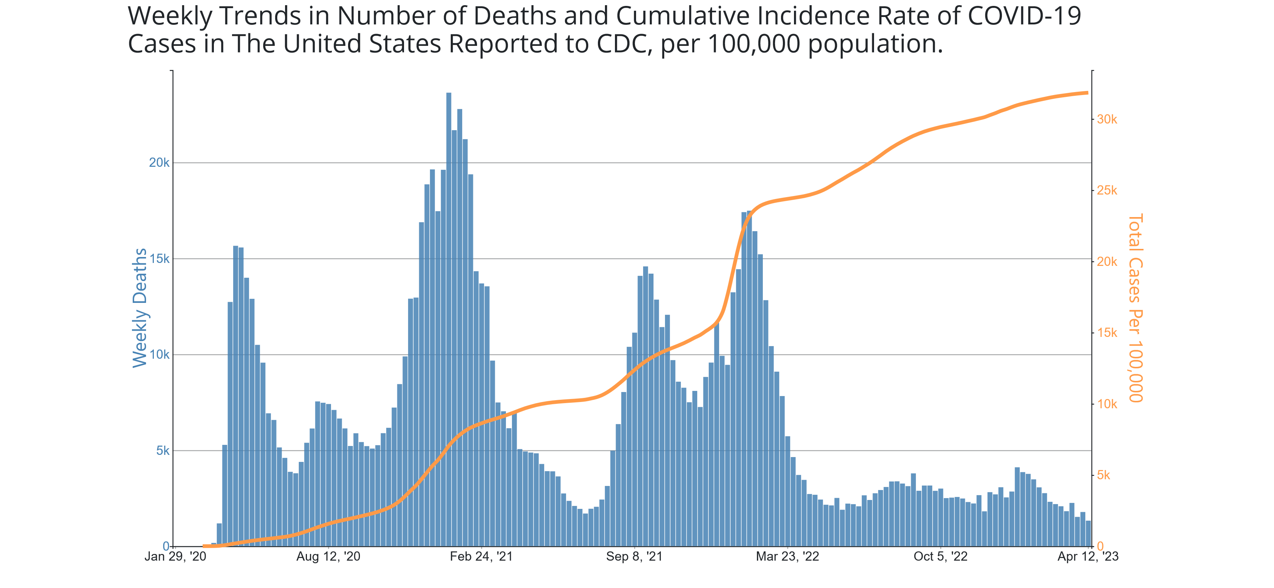
Healthcare and the Covid-19 Pandemic
[8]

Slide 8
Related Work
Long COVID Computational Challenge 2023:
“The primary objective of the Long COVID Computational Challenge (L3C) is to focus on the prognostic problem by developing AI/ML models and algorithms that serve as open-source tools for using structured medical records to identify which patients infected with SARS-CoV-2 have a high likelihood of developing PASC/Long COVID”[6]
Models:
Logistic Regression, Random Forest, Gradient Boosting, Decision Tree
Feature Selectors:
Variance Threshold, Logistic Regression (vanilla/permutation), Random Forest (vanilla/recursive elimination/permutations), Ridge Regression regularization, Sequential feature Selection
Data Set | Rows X Columns (% missing values)
 | Test | Train
care_site | 8,367 x 8 (66%) | 26 x 8 (1%)
condition_era | 2,484,521 x 8 (0%) | 13,639 x 8 0%
condition_occurrence | 6,316,765 x 21 (37%) | 36,451 x 21 (35%)
condition_to_macro | 1,286,673 x 8 (6%) | 8,388 x 8 (5%)
device exposure | 422,167 x 19 (44%) | 2,836 x 19 (45%)
drug_era | 2,090,455 x 9 (0%) | 12,698 x 9 (0%)
drug_exposure | 13,611,559 x 28 (42%) | 66,050 x 28 (39%)
location | 25,142 x 9 (57%) | 281 x 9 (60%)
long COVID | 57,675 x 2 (13%) | 300 x 2 (0%)
manifest_safe | 69 x 6 (23%) | 300 x 13 (23%)
measure | 32,569,723 x 29 (33%) | 198,151 x 30 (33%)
measure_to_macro | 17,839,906 x 8 (0%) | 112,243 x 8 (2%)
micro_to_macro | 3,524,398 x 28 (54%) | 19,430 x 26 (54%)
note | 321,151 x 19 (59%) | 2,710 x 19 (66%)
note_nlp | 7,580,262 x 21 (38%) | 60,486 x 21 (45%)
observation | 6,869,266 x 25 (49%) | 43,355 x 25 (43%)
observation_period | 45,404 x 7 (0%) | 234 x 7 (0%)
payer_plan_period | 1,370,746 x 26 (69%) | 6,029 x 26 (69%)
person | 57,672 x 26 (29%) | 300 x 26 (28%)
procedure_occurrence | 278,981 x 19 (22%) | 14,645 x 19 (23%)
procedures_to_macro | 991,579 x 8 (5%) | 5,247 x 8 (5%)
provider | 31,664 x 18 (51%) | 477 x 18 (56%)
visit_occurrence | 350,934 x 23 (49%) | 19,411 x 23 (49%)
Notes:
With access to 17,411,971 patient records with demographic information, 1,092,858 patient records with condition information, 16,908,022 patient records with observation information, and 14,613,563 patient records with drug information, as well as 207 conditions and 6,128 patients labeled as COVID-19-related and death records for 475,085 patients.

Slide 9
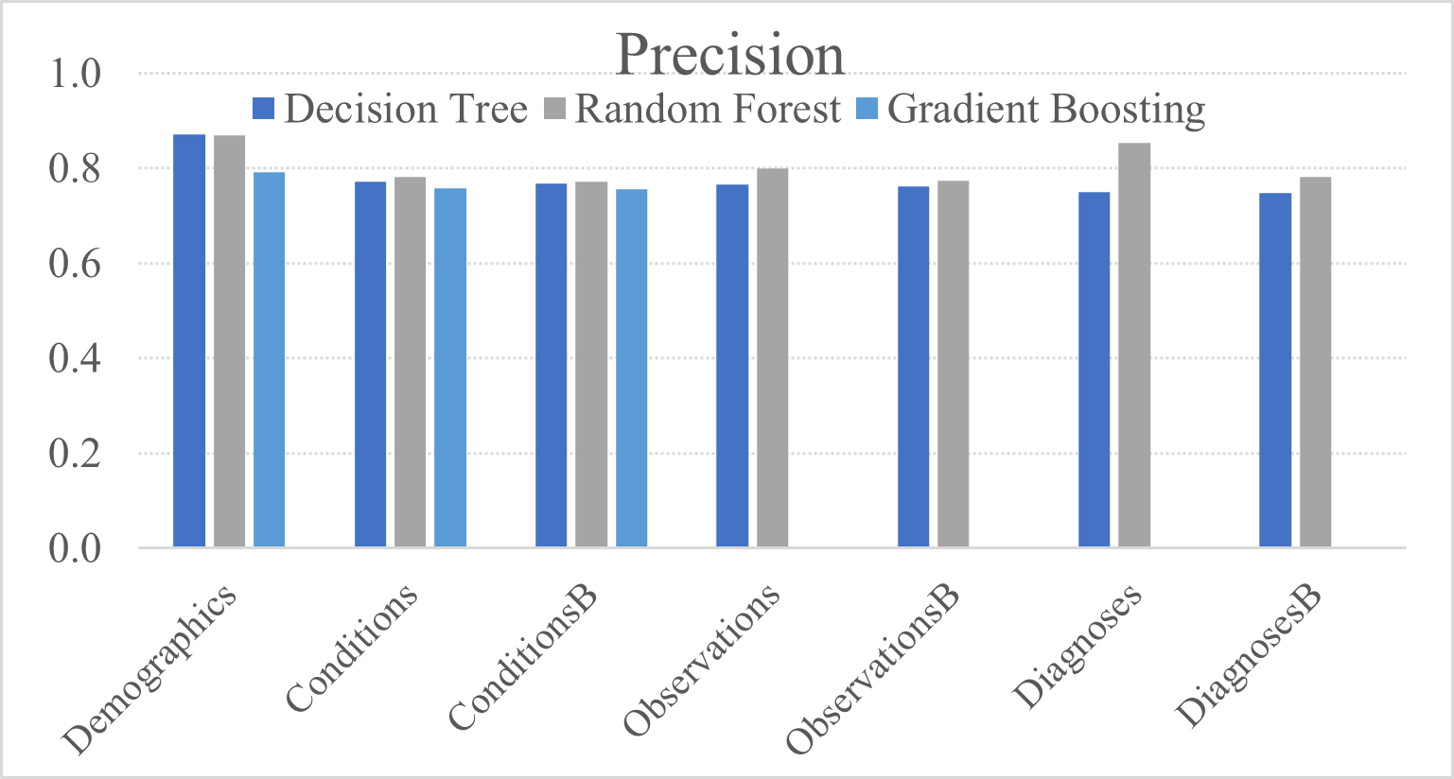
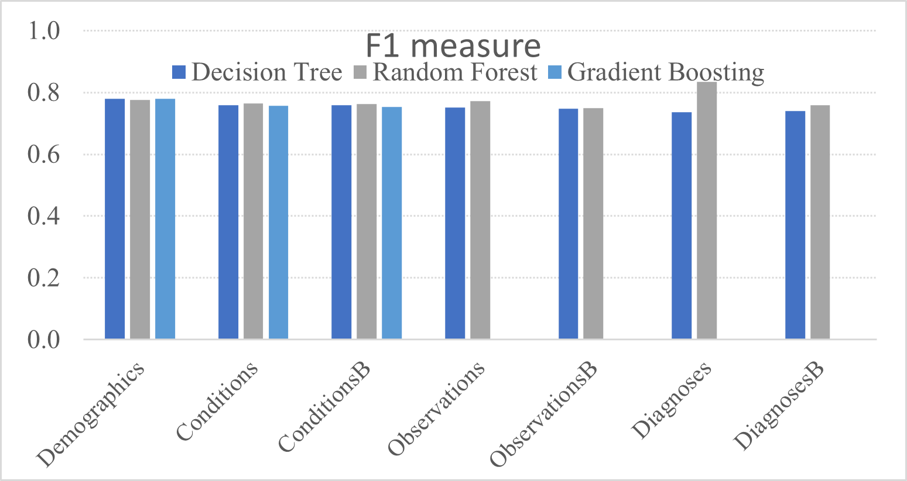
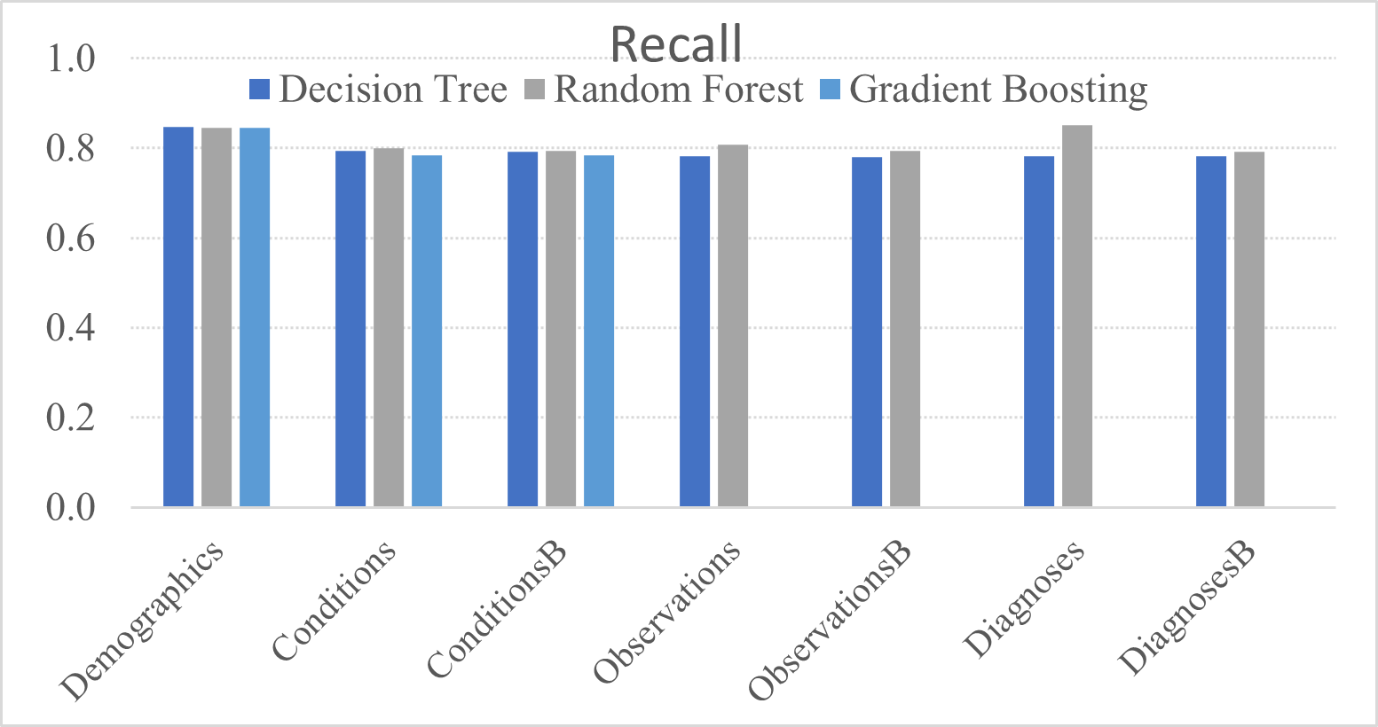
Why Random Forest?

Slide 10
Methodology
Person
Conditions
Drugs
Observations
Death
Known:
Not every file or column in N3C is relevant
No longer have the ‘Long Covid’ label but do have death
One patient can have multiple conditions, observations, and drugs per visit (occurrence or era).
Encoding the fields as binary or numerical had no impact on modeling performance across three data frames.
Early aggregation decisions that impacted the outcome.
How to predict missing age using a Logistic Regression model.
Notes:
What exactly have you done? And implemented. Why?

Slide 11
Exploratory Data Analysis
The death dataset will be used to create the ‘deceased’ label.
Similar to the L3C we have missing values for the ‘year_of_birth’ column, 755,897 patients.
By utilizing the available features and a simple logistic regression model, I predict the missing values.
Concepts with more than 1M patients per concepts were selected for our ‘sample’ representing at least 14,316,720 patients.
Dataset | Rows | Org Column # | Columns Used | # Patient | # Concepts | # Represented | Deceased
person | 18,844,666 | 27 | 7 | 18,844,666 | 3 | 20 | 539,898
death | 539,898 | 11 | 1 | 539,898 | 1 | label | 539,898
condition_era | 369,865,270 | 8 | 4 | 16,018,541 | 172 | 172 | 475,033
condition_occurence | 1,501,045,034 | 21 | 3 | 16,718,137 | 524 | 524 | 488,133
observations | 1,135,698,679 | 25 | 5 | 17,588,418 | 155 | 155 | 484,253
drug_exposure | 2,546,430,059 | 28 | 28 | 15,520,199 | 732 | 732 | 96,379
drug_era | 672,699,925 | 9 | 9 | 14,316,720 | 226 | 226 | 94,880

Slide 12
Patient Counts Over All Concept Id’s

Slide 13
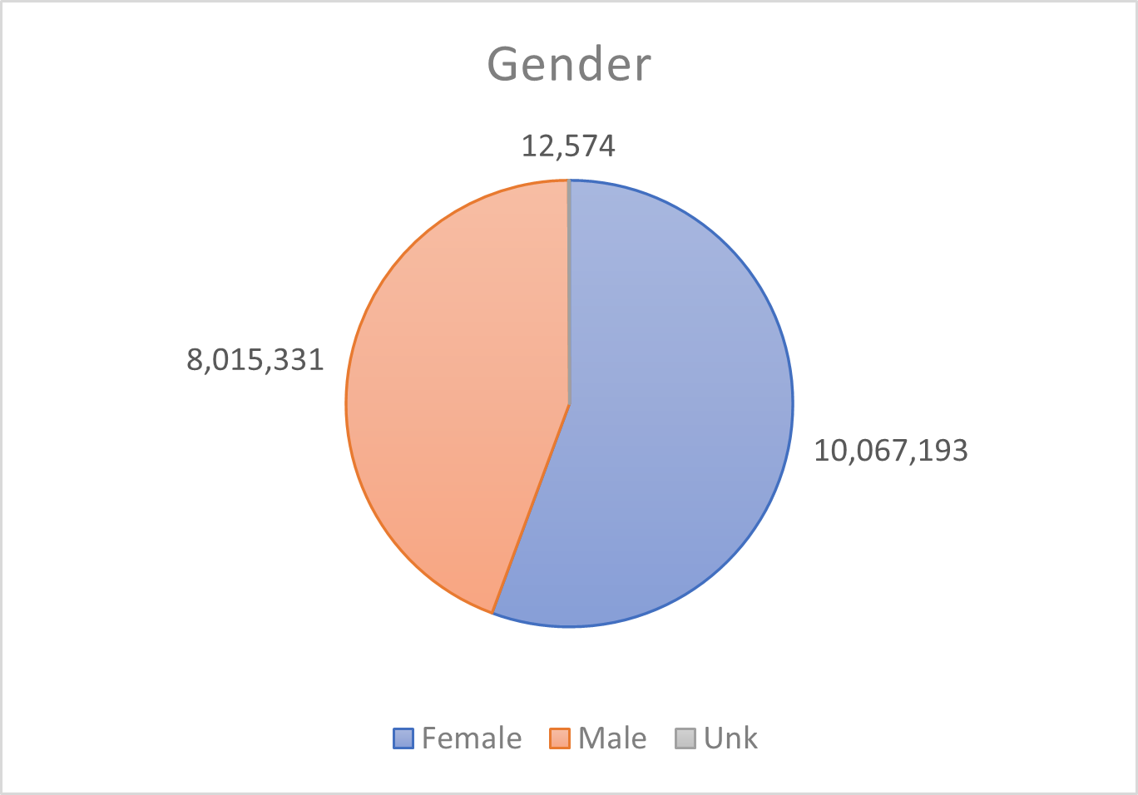
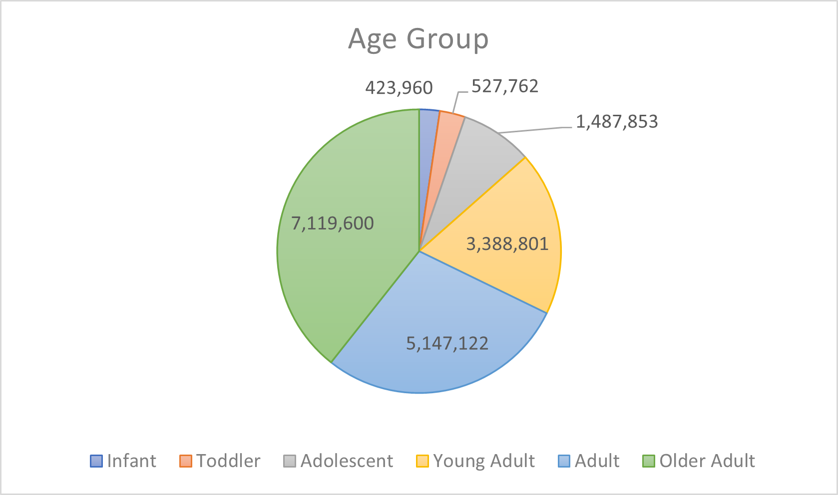
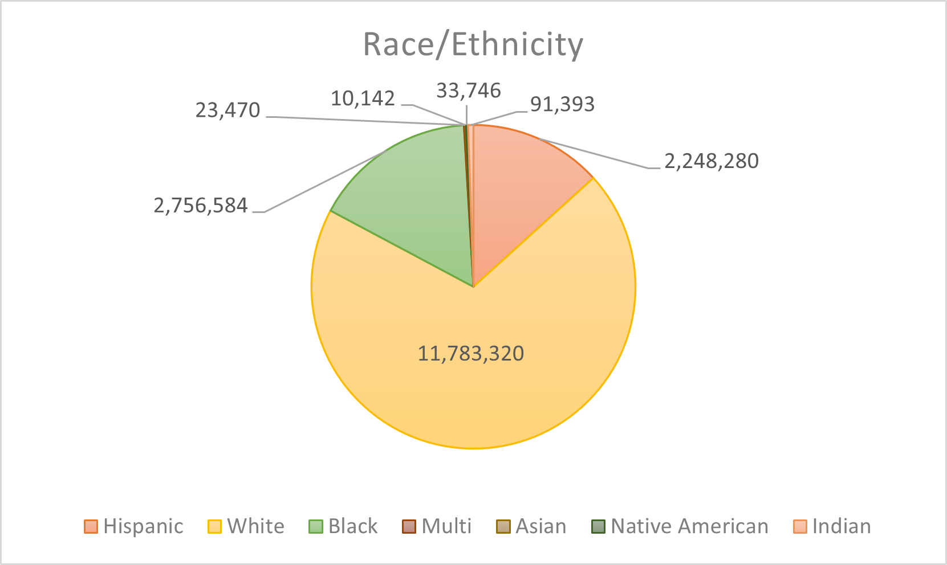
Demographics

Slide 14
PySpark Feature Selectors
condition_era
Logistic Regression
Random Forest
condition_occurrence
Logistic Regression
observation
drug_era
drug_exposure
Logistic Regression
Logistic Regression
Logistic Regression
Univariate
(chi-squared)
Random Forest
Univariate (chi-squared)
Random Forest
Univariate (chi-squared)
Random Forest
Univariate (chi-squared)
Random Forest
Univariate (chi-squared)
Model | Parameter | Value
Random Forest | maxCategories | 4
 | numTree | 10
Logistic Regression | maxIter | 10
 | regParam | 0.3
 | elasticNetParam | 0.1
Both | seed | 42
Notes:
Univariate default: hyper-parameters affect false positive rate

Slide 15
Top 25 concept-id’s selected:
condition_era | condition_occurence | observations | drug_exposure | drug_era
440704 | 4149353 | 4353940 | 9202 | 1759206
441408 | 4147829 | 4290243 | 141693 | 1771162
442077 | 4146581 | 4282779 | 432426 | 1777806
442588 | 4146209 | 4277123 | 435928 | 1786621
442752 | 4144111 | 4271661 | 436583 | 1790812
4077577 | 4142875 | 4237719 | 437525 | 1796458
4059290 | 4141360 | 4225511 | 437643 | 1799139
4043042 | 4134121 | 4215685 | 439141 | 1836430
4041283 | 4128329 | 4196943 | 439224 | 19003953
4079750 | 4171917 | 46272451 | 441207 | 19005965
4134121 | 4170554 | 4188893 | 441482 | 1754994
4144111 | 4169954 | 36304041 | 443364 | 19005968
4146581 | 4169095 | 4186037 | 704996 | 19011035
4147829 | 4168796 | 4167217 | 762498 | 19011773
4154290 | 4168700 | 4152283 | 762499 | 19019073
4169095 | 4166231 | 4148407 | 1340204 | 19019418
4170554 | 4164898 | 4124779 | 2101897 | 19035704
4171917 | 4155909 | 4117957 | 2101941 | 19036781
4174262 | 4154290 | 4108442 | 2101944 | 19037038
4180628 | 4152384 | 4093836 | 2102034 | 19045045
4193704 | 4152351 | 4082209 | 2106285 | 19049105
4195085 | 4150125 | 4081759 | 2106286 | 19009405
4201745 | 4180628 | 4060985 | 2313972 | 1748975
4203722 | 4174262 | 4174707 | 2414345 | 1746940
4209423 | 4172970 | 4060705 | 2514400 | 1373928
Notes:
Modeling: include precision and recall Acc is misleading.. Whythese 2 models … whythe data frames. Make this confusion matrix for all

Slide 16
Modeling
Data Frame | Random Forest |  |  |  |  | Logistic Regression |  |  | Test
 | TN | TP | FP | FN | TN | TP | FP | FN | Test
condition_era | 3106962 | 0 | 0 | 94701 | 3106954 | 0 | 0 | 94772 | 3201655
condition_occurence | 3244811 | 0 | 0 | 97426 | 3244811 | 0 | 0 | 97426 | 3342237
observations | 3419498 | 0 | 0 | 96549 | 3419316 | 185 | 237 | 96311 | 3516050
drug_exposure | 601476 | 0 | 0 | 19325 | 601710 | 0 | 0 | 19171 | 621035
drug_era | 553248 | 0 | 0 | 18805 | 553616 | 0 | 0 | 18805 | 572421

Slide 17
Conclusion
Objective: The pipeline is optimized for deployment on N3C Enclave and aims to inform clinical decisions by identifying the most relevant factors that would lead to death. The study implements three feature selectors and two machine learning methods in PySpark (v3.4) on the Enclave for processing noisy tabular data.
Early aggregation decisions impacted the outcome of the related work but by analyzing each dataset individually we see:
The observations dataset distribution of class labels (0: alive : 1: deceased) allowed the Logistic Regression model to predict negative and positive labels.
The Random Forest models were ONLY able to make predictions of low probabilities of being a positive case (deceased), negative cases. This is due to the number of death records (539,898); we have in comparison to overall patient records (14,316,720-18,844,666) .
In terms of the Enclave, overall runtime was reduced, and transformations ran in unison without interrupting or corrupting others.
Enclave = Cohorts
Notes:
So many significant factors are still missing, COVID,
Enclave should be better at different issues/groups

Slide 18
Future Work
N3C Multi-Source Patient Linkage and Patient De-Duplication
“N3C data enhancement: site-to-site patient de-duplication using Privacy Preserving Record Linkage (PPRL). While N3C has so far used PPRL to link data-partner-provided EHR records to supplemental data such as mortality information, we now have the ability to link patient records across data partners that are participating in PPRL linkage”
Currently 41/58 data partners have committed to site-to-site, linkage, 24/58 mortality linkage, and 40/45 are participating in Medicaid linkage. Palantir Foundry and N3C are still promoting partner participation.
The Enclave is set to represent 5% of the USA population accounting for 1 in 20 people.
Maternal mortality resulting from a positive Covid-19 test or hospital stay before/during pregnancy. Currently fetuses that are exposed to Covid-19 have been born with a compromised immune system, experience still-birth, premature birth or in severe cases death.
The global patient identifiers should assist in optimizing the current pipeline and models to better represented the population.

Slide 19
References:
[1] National Covid Cohort Collaborative (N3C). (n.d.). National Covid Cohort Collaborative (N3C). Retrieved April 18, 2023, from https://covid.cd2h.org/n3c
[2] Phenotype &amp; Data Acquisition Workstream. Phenotype &amp; Data Acquisition Workstream | N3C. (n.d.). Retrieved April 18, 2023, from https://covid.cd2h.org/N3C_phenotype
[3] N3C Data Enclave Tools. N3C. (n.d.). Retrieved April 18, 2023, from https://covid.cd2h.org/tools
[4] PySpark programming: What is pyspark?: Introduction to pyspark. Edureka. (2022, November 18). Retrieved April 18, 2023, from https://www.edureka.co/blog/pyspark-programming/
[5] U.S. Department of Health and Human Services. (n.d.). U.S. Department of Health and Human Services. National Institutes of Health. Retrieved April 18, 2023, from https://unite.nih.gov/docs/foundry/transforms-python/pyspark-overview/
[6] Sage Bionetworks, info@sagebase.org. (n.d.). Sage bionetworks. Synapse. Retrieved April 18, 2023, from https://www.synapse.org/#!Synapse:syn33576900/wiki/
[7] OMOP. (n.d.). Common Data Model. OMOP Common Data Model. Retrieved April 18, 2023, from https://ohdsi.github.io/CommonDataModel/index.html
Acknowledgments:
The analyses described in this presentation were conducted with data or tools accessed through the NCATS N3C Data Enclave https://covid.cd2h.org and N3C Attribution & Publication Policy v 1.2-2020-08-25b supported by NCATS U24 TR002306, Axle Informatics Subcontract: NCATS-P00438-B. This research was possible because of the patients whose information is included within the data and the organizations (https://ncats.nih.gov/n3c/resources/data-contribution/data-transfer-agreement-signatories) and scientists who have contributed to the on-going development of this community resource [https://doi.org/10.1093/jamia/ocaa196].

Slide 20
THANK YOU!

